Slide 1
Smart street lighting system
Team:- N.Abhiram (1602-20-737-121)
D.Kiran (1602-20-737-139)
K.Saketh (1602-20-737-165)

Slide 2
SIH 2022 PS DETAILS
Problem statement : An automated feedback system to know the exact location of non-functional street lights in rural/urban areas of India . Also automatic turning on & off according to the surroundings.
PS No : ST888
Thrust Area : Miscellaneous

Slide 3
TABLE OF CONTENTS
01
02
04
03
ABSTRACT
Description about project
05
Technologies used
Use case paradigm
Test cases

Slide 4
ABSTRACT
Good Street lighting systems in rural areas improve road safety, personal security and raise the standard of living. Street lighting also improves safety for drivers, riders, and pedestrians on roads, where the road conditions are sometimes not of the desired standards. Streetlights have been installed in many villages and state highways in Central India. However, many times these lights remain non- functional due to late information about the exact location and unavailability of sufficient service support. Consequently, in the absence of proper lighting, some of these areas become unsafe for people at night especially elders, women, and children. An automated feedback system based on a software may allow the service engineers to know the exact location of non-functional streetlights in their areas of responsibility. And also to ensure maximum efficiency and energy saving purpose a system is also designed in such a way that light is switched on or off depending upon its environment.

Slide 5
DESCRIPTON ABOUT PROJECT
We tend find the street lights which are not working properly (faulty) through a LDR(photoresistor) that placed under the street light.
The Arduino is coded in such a way that the emitting light intensity is calculated and if the calculated value is less than the required lux value that is 10 then Arduino triggers a signal.
This signal is moved to Ublox module where the geographical location consisting of latitude and longitude are taken.
The data about geographical location and time stamp is transmitted to the webserver using
WIFI module(ESP 8266).
These latitude and longitude values are then decoded into a real time location using GeoPy module present in python.
The time stamp and geographical location are stored in the webserver and we trigger a request to the service operator present in the nearby area.
The service operator receives a request when there is fault detected and when the request is completed the service operator resets the device.

Slide 6
DESCRIPTON ABOUT PROJECT
Also the street lights are equipped with IR (Infrared ) sensors which is capable of detecting any kind of motion .
The motion detected is then considered as an input and the light is set to high meaning light is ON.
The LDR is again used to detect the light intensity after the IR sensors input and light ON as output.
This confirms whether the light is properly working or is it faulty.
Another feature is that the lights are automatically tend to ON or OFF based on the LDR input. Here the input is taken from the environment that Is whether is it sunny or night outside.

Slide 7
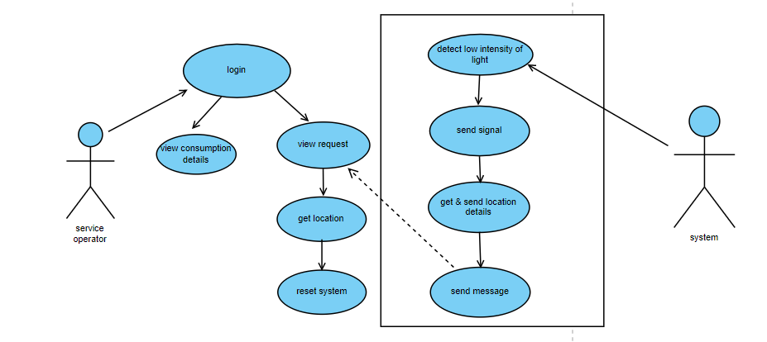
USE CASE PARADIGM
l

Slide 8


TECHNOLOGIES USED
Hardware :-
Arduino Uno
Ublox Neo – 6M
LDR
ESP 8266
IR Sensor
Software:-
HTML,CSS and PHP
MYSQL
Python GeoPy
ARDUINO IDE

Slide 9
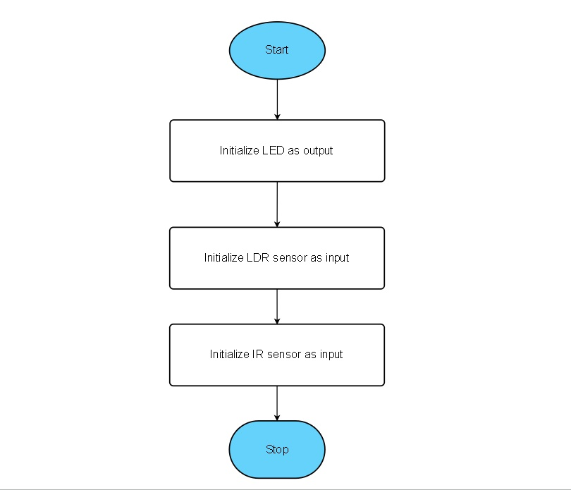
Program Flow Chart-I
Setup() :-
l

Slide 10
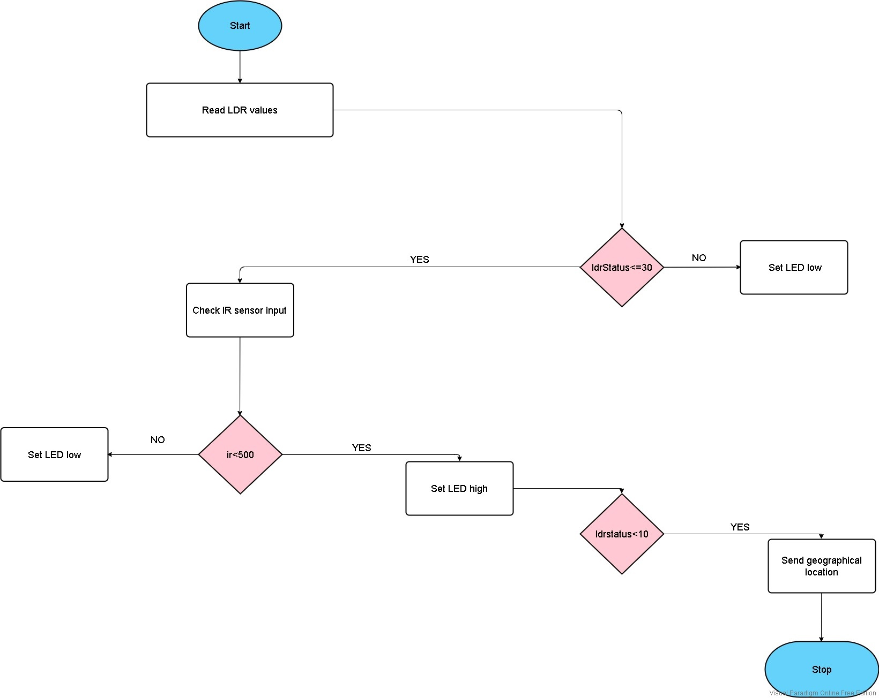
Program Flow Chart-II
Loop() :-
l

Slide 11
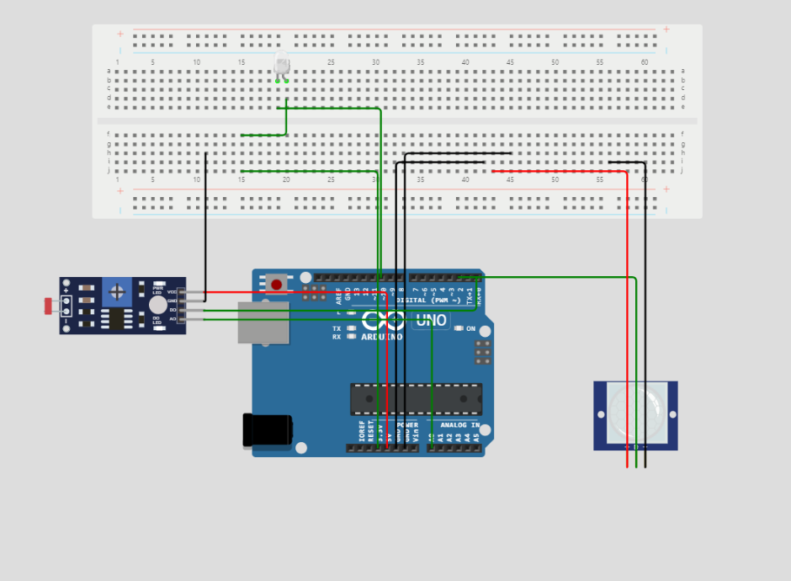
IOT SYSTEM CIRCUIT DESIGN

Slide 12
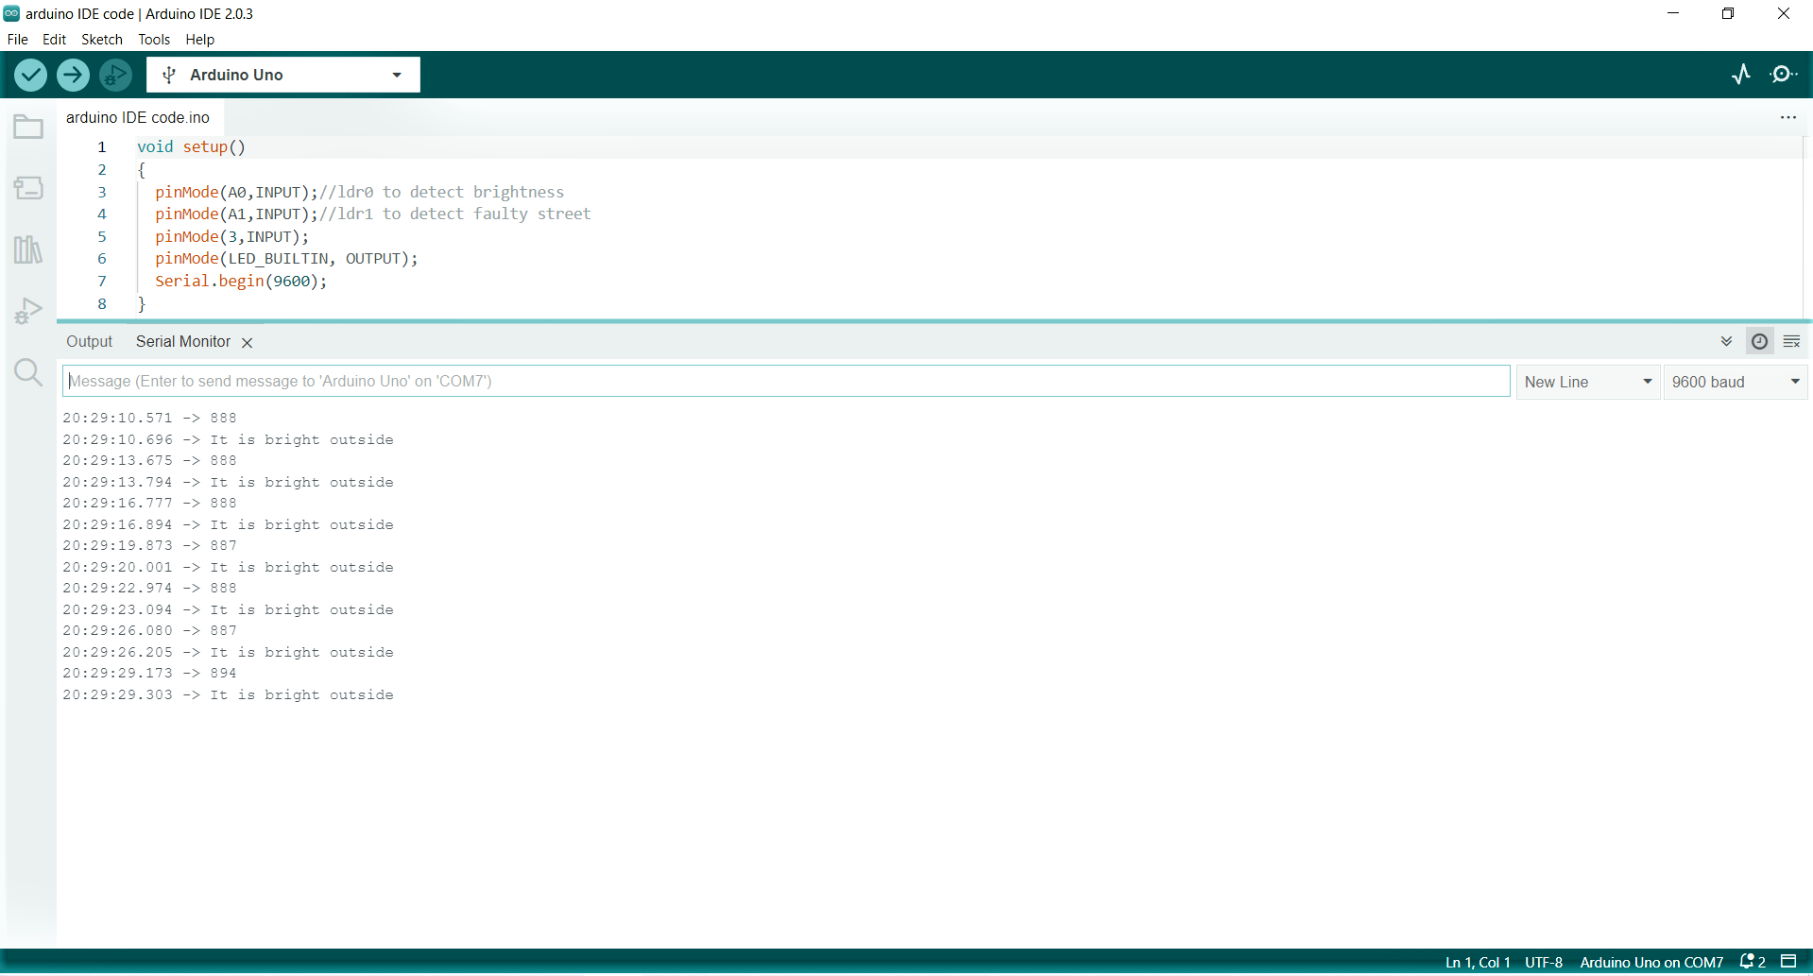
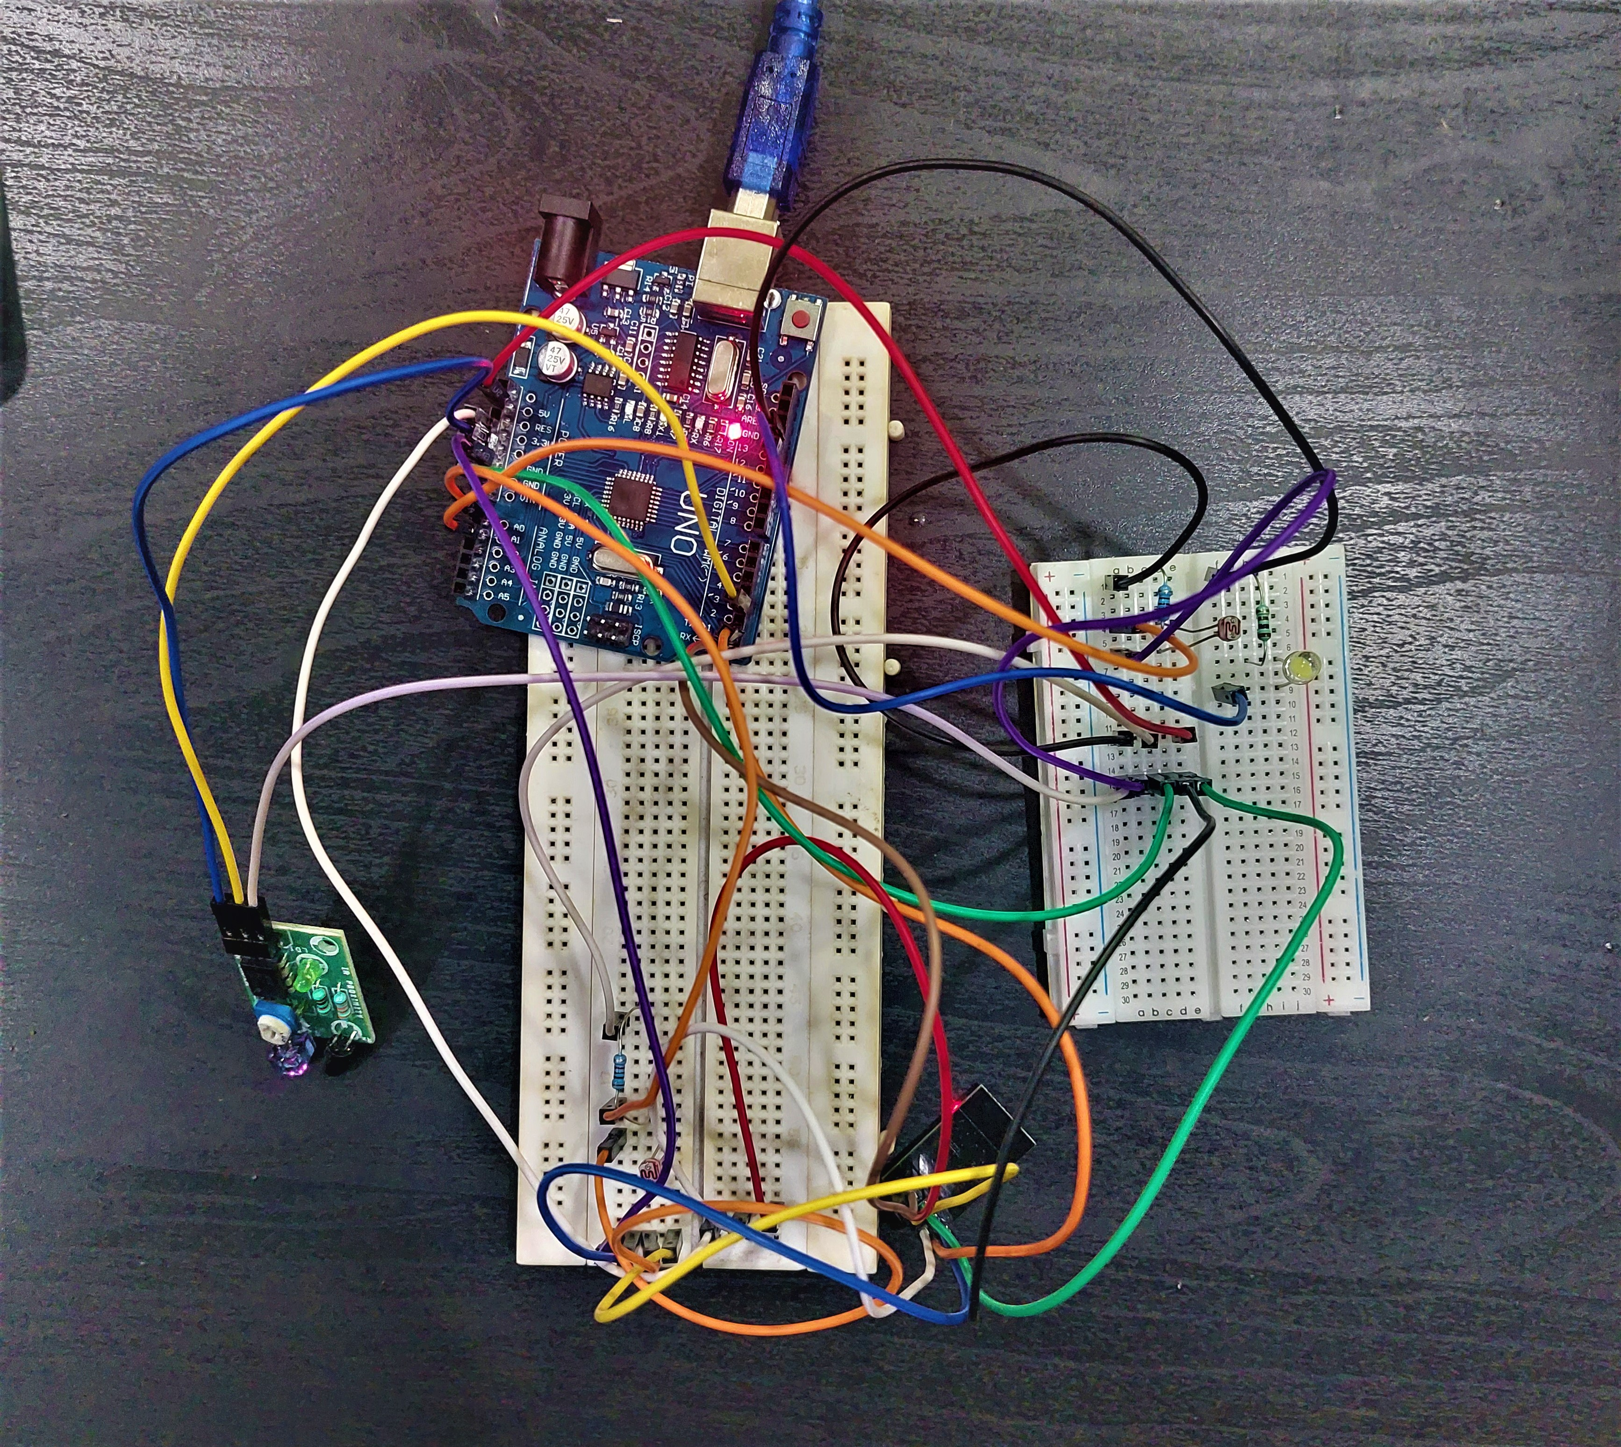
TEST CASES
Case 1
Description:- The LDR sensor should detect the high intensity of light meaning it is day outside.
Pre-condition :- LDR lux value should be less than 900 units.
Expected output :- The system should display the condition and the lux value.
OUTPUT SCENARIO :-

Slide 13
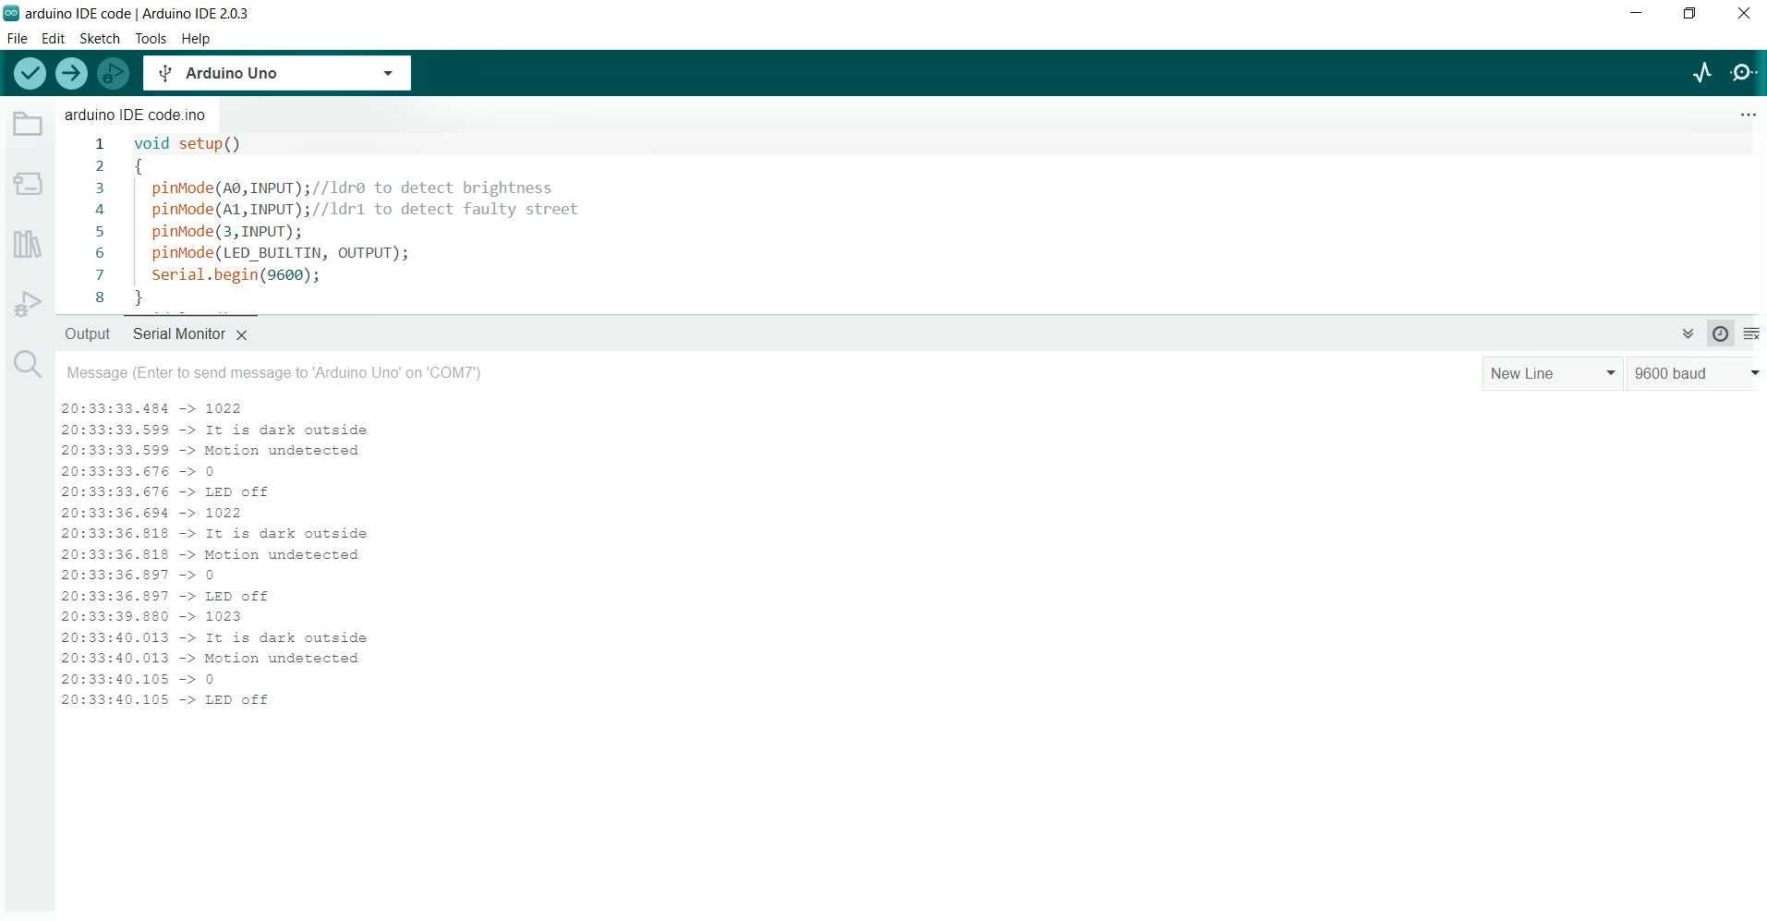
TEST CASES(cont..)
Case 2
Description:- The LDR sensor should detect the low intensity of light and should identify any object.
Pre-condition :- LDR lux value should be more than 900 units and no motion is detected.
Expected output :- The system should display the lux value and motion status.
OUTPUT SCENARIO :-

Slide 14
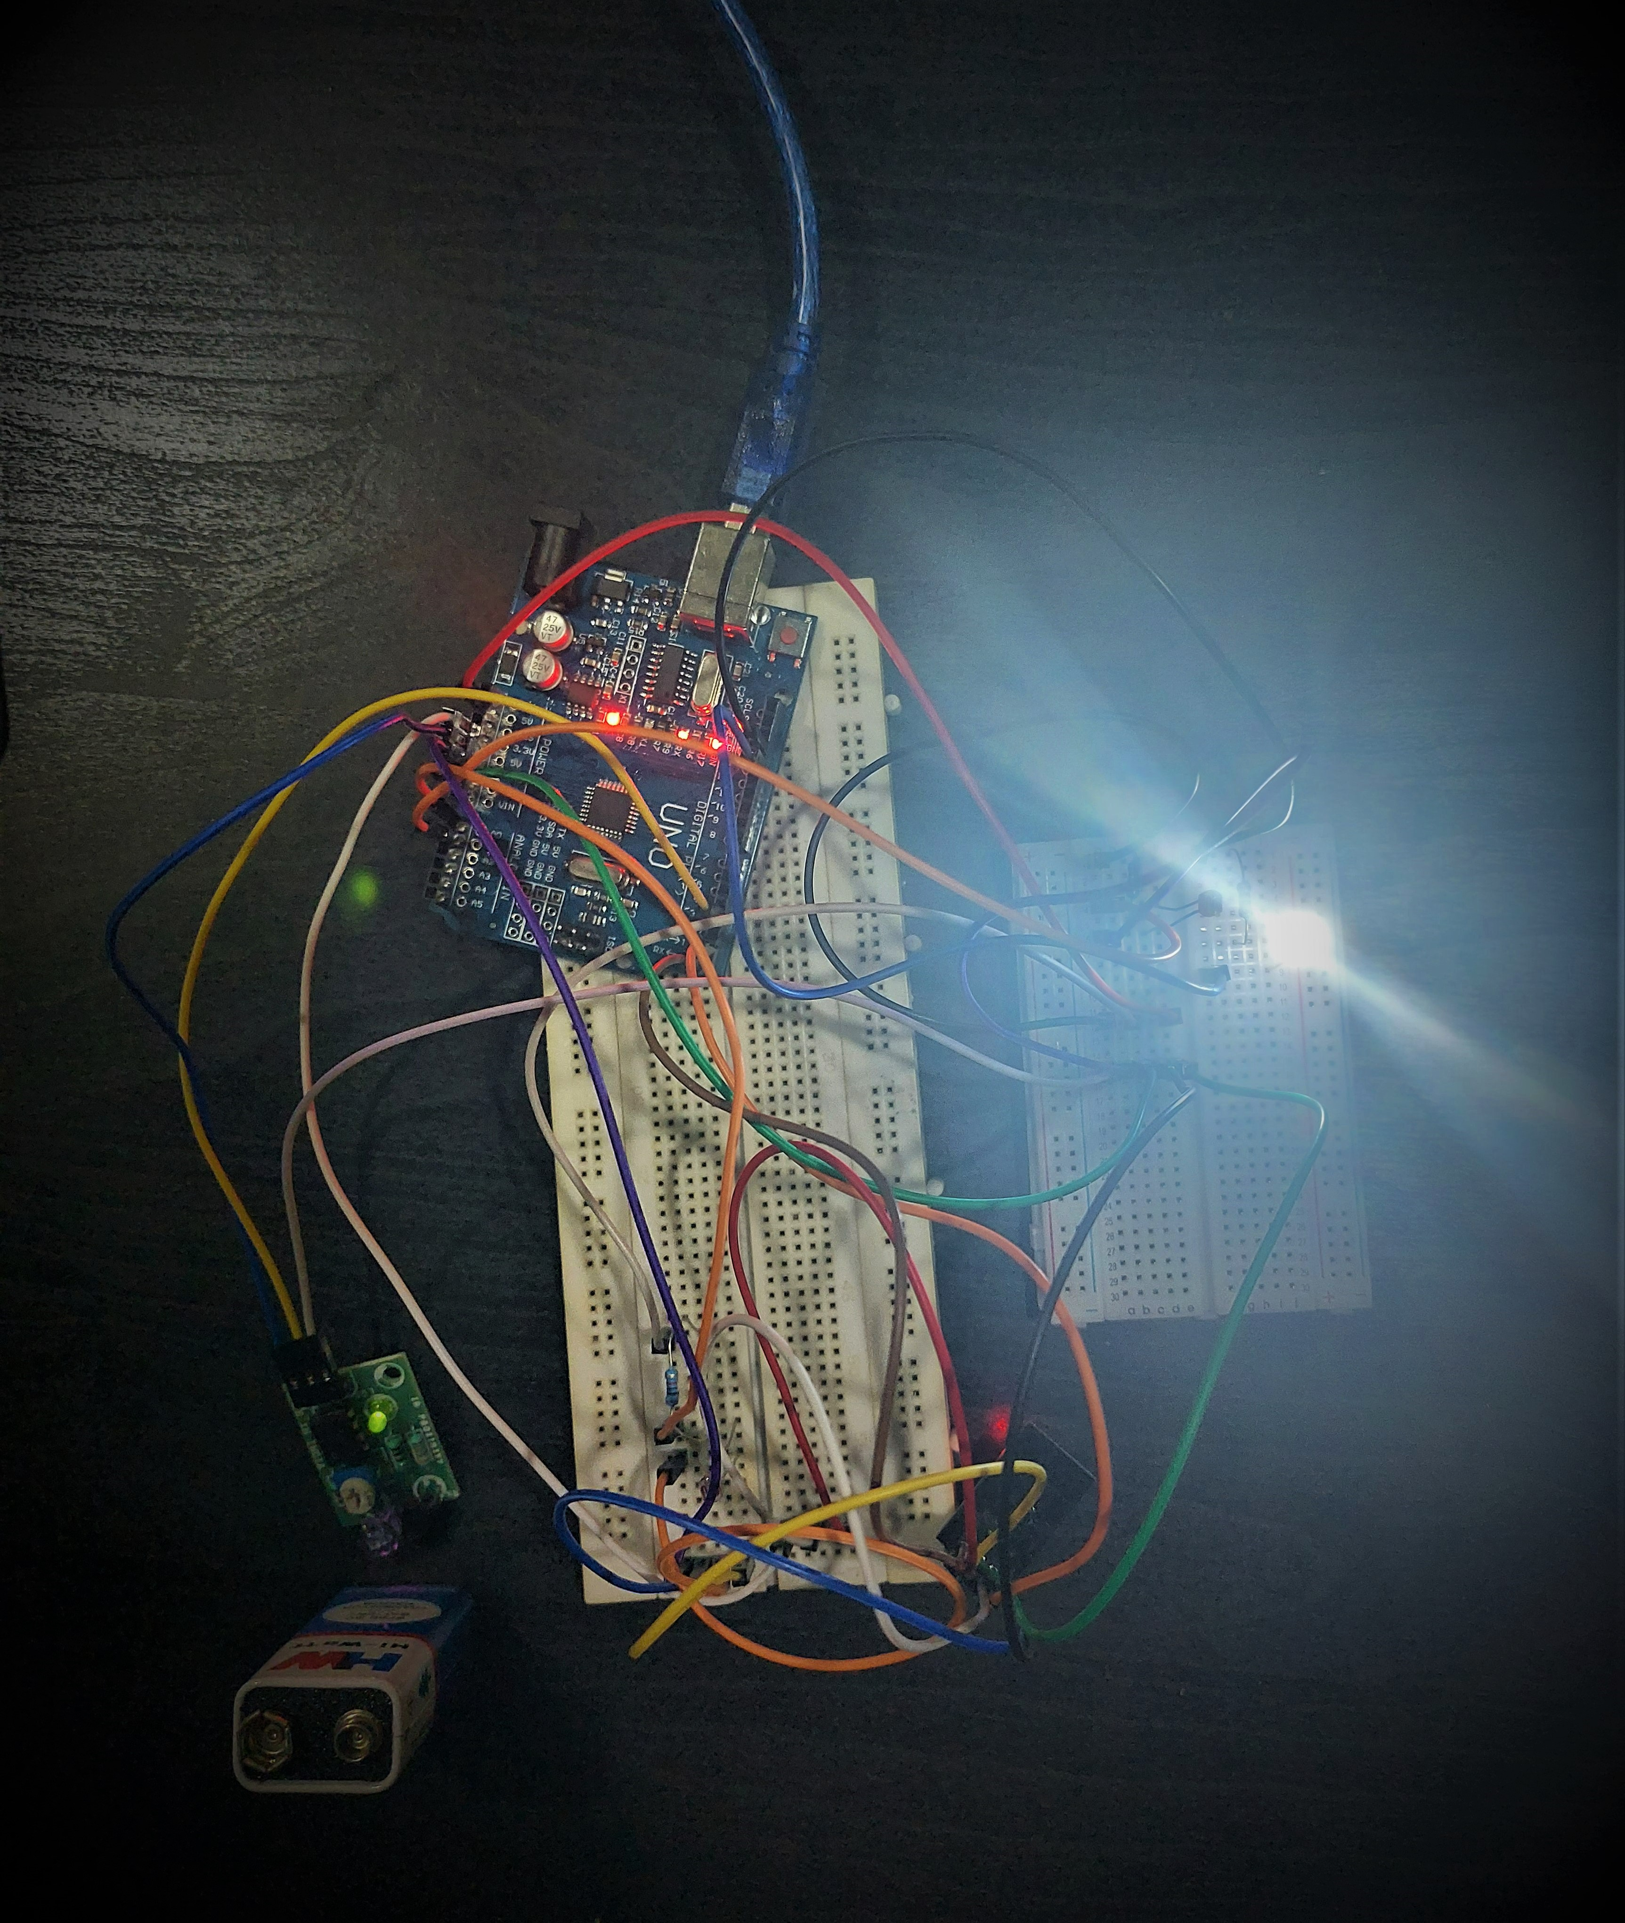
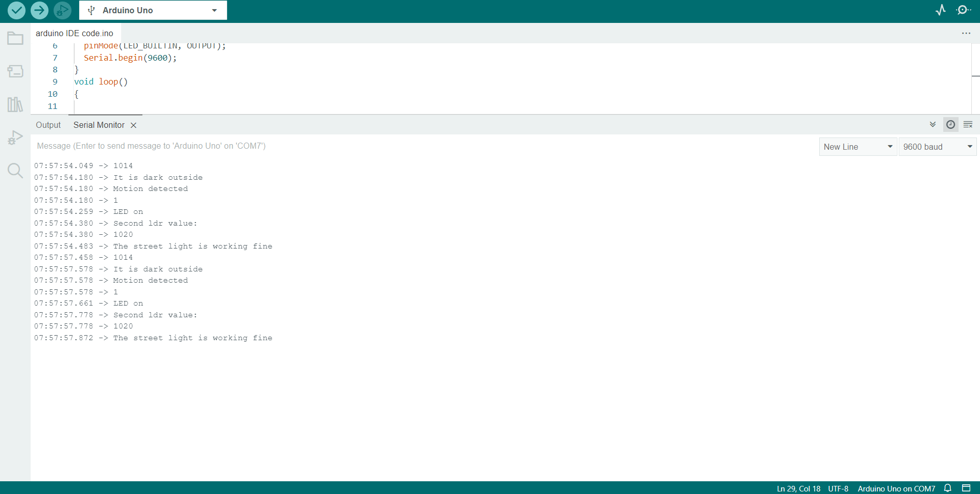
TEST CASES(cont..)
Case 2.1
Description:- The LDR sensor should detect the low intensity of light and should identify any object.
Pre-condition :- LDR lux value should be less than 900 units and the motion is detected.
Expected output :- The system should turn the LED on and LED should be at maximum brightness.
OUTPUT SCENARIO :-

Slide 15

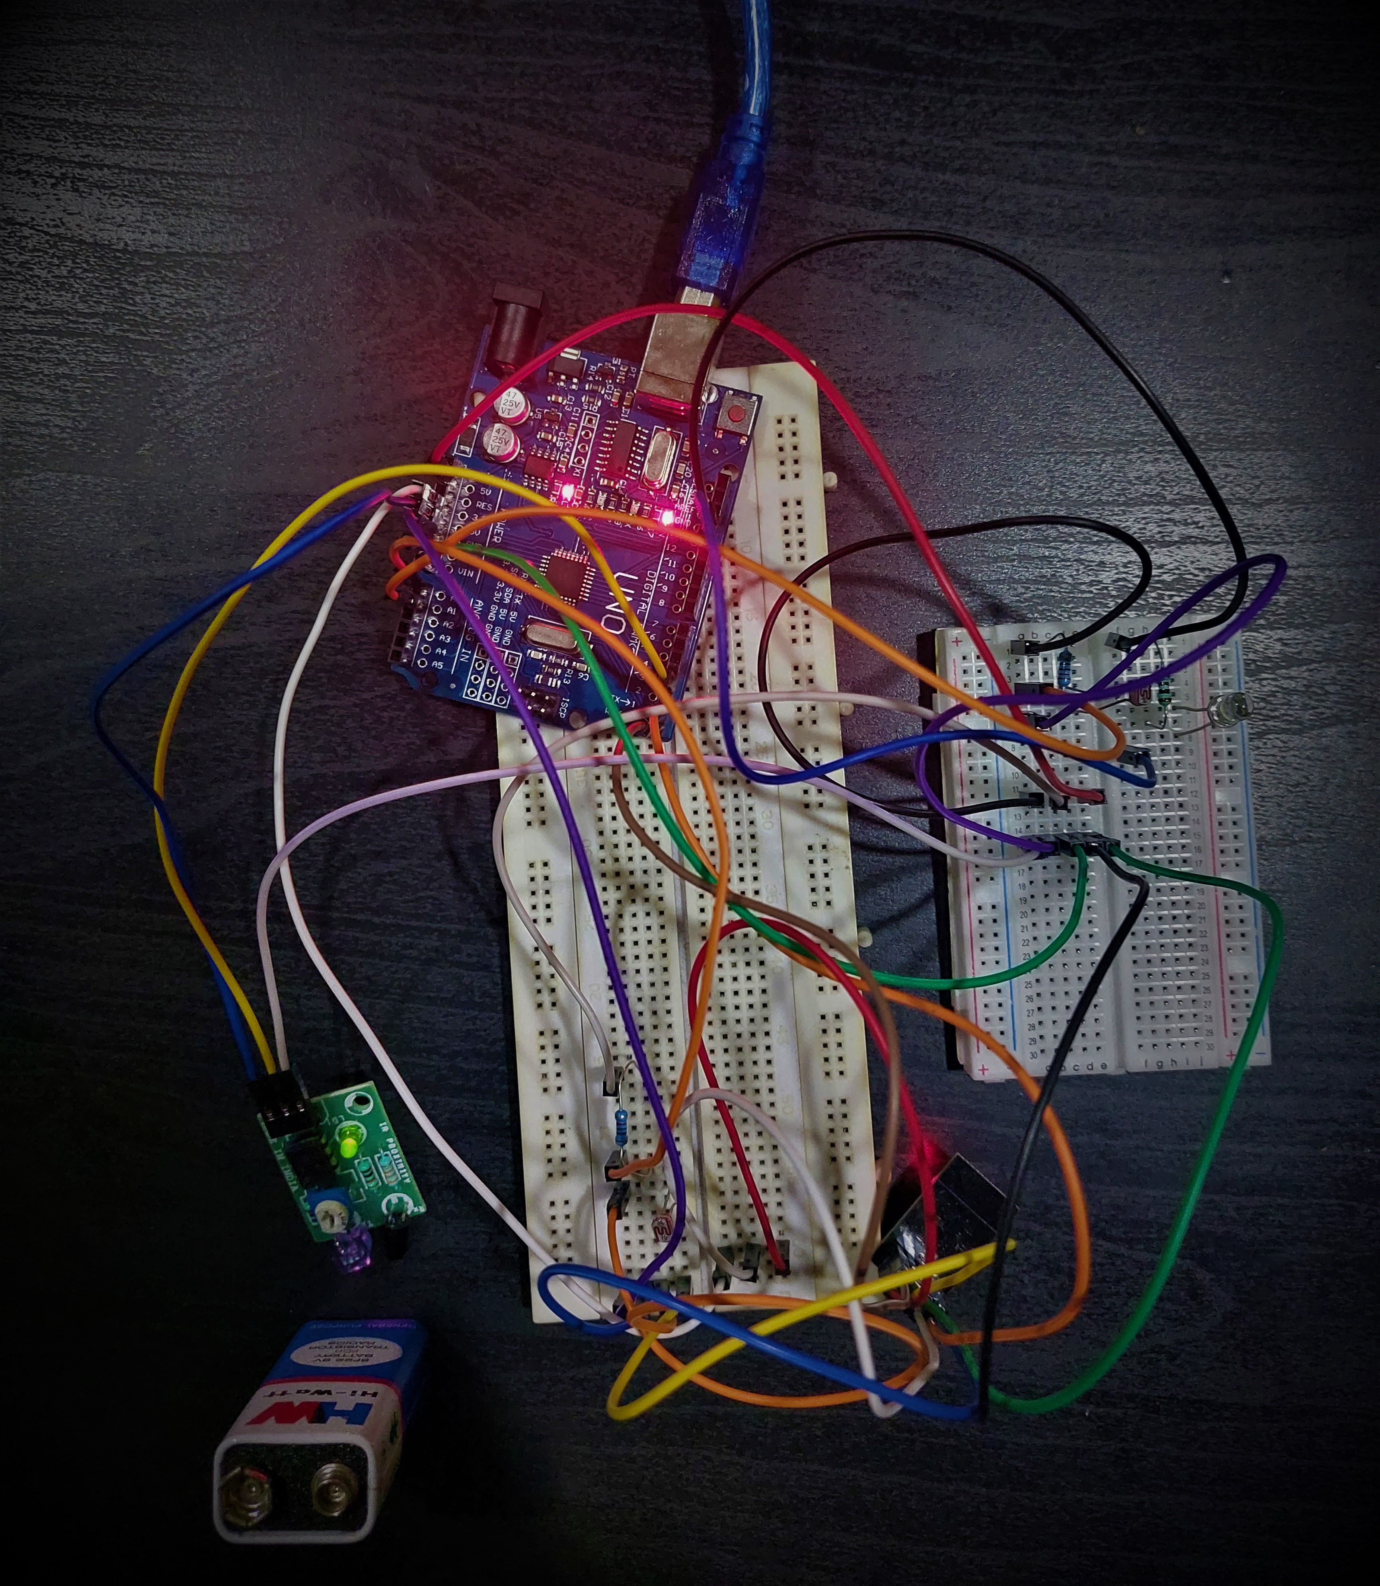
TEST CASES(cont..)
Case 3:
Description:- The LDR sensor should detect the Low intensity of light and one IR sensor should detect the motion and the street light is faulty.
Pre-condition :- LDR lux value should be less than 900 units and the IR sensor should detect motion. Also the second LDR should detect the faulty street light.
Expected output :- The system should send the geographical location to the webserver.
OUTPUT SCENARIO :-

Slide 16
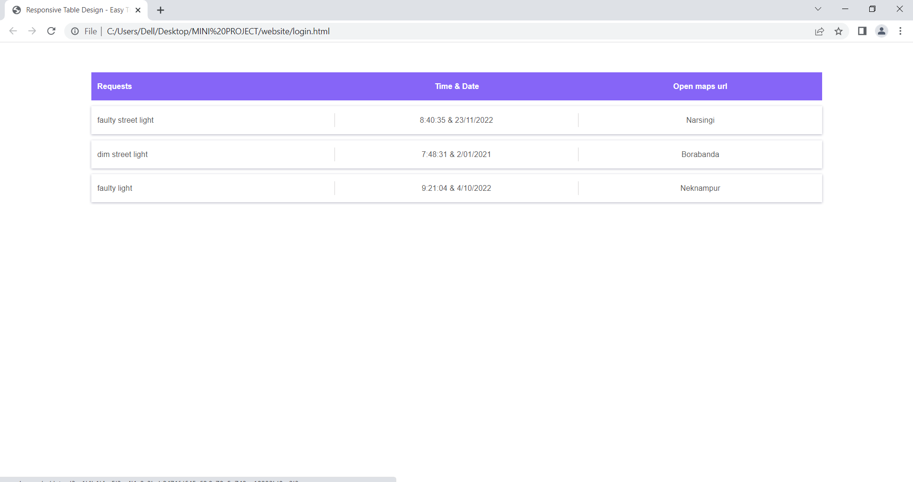
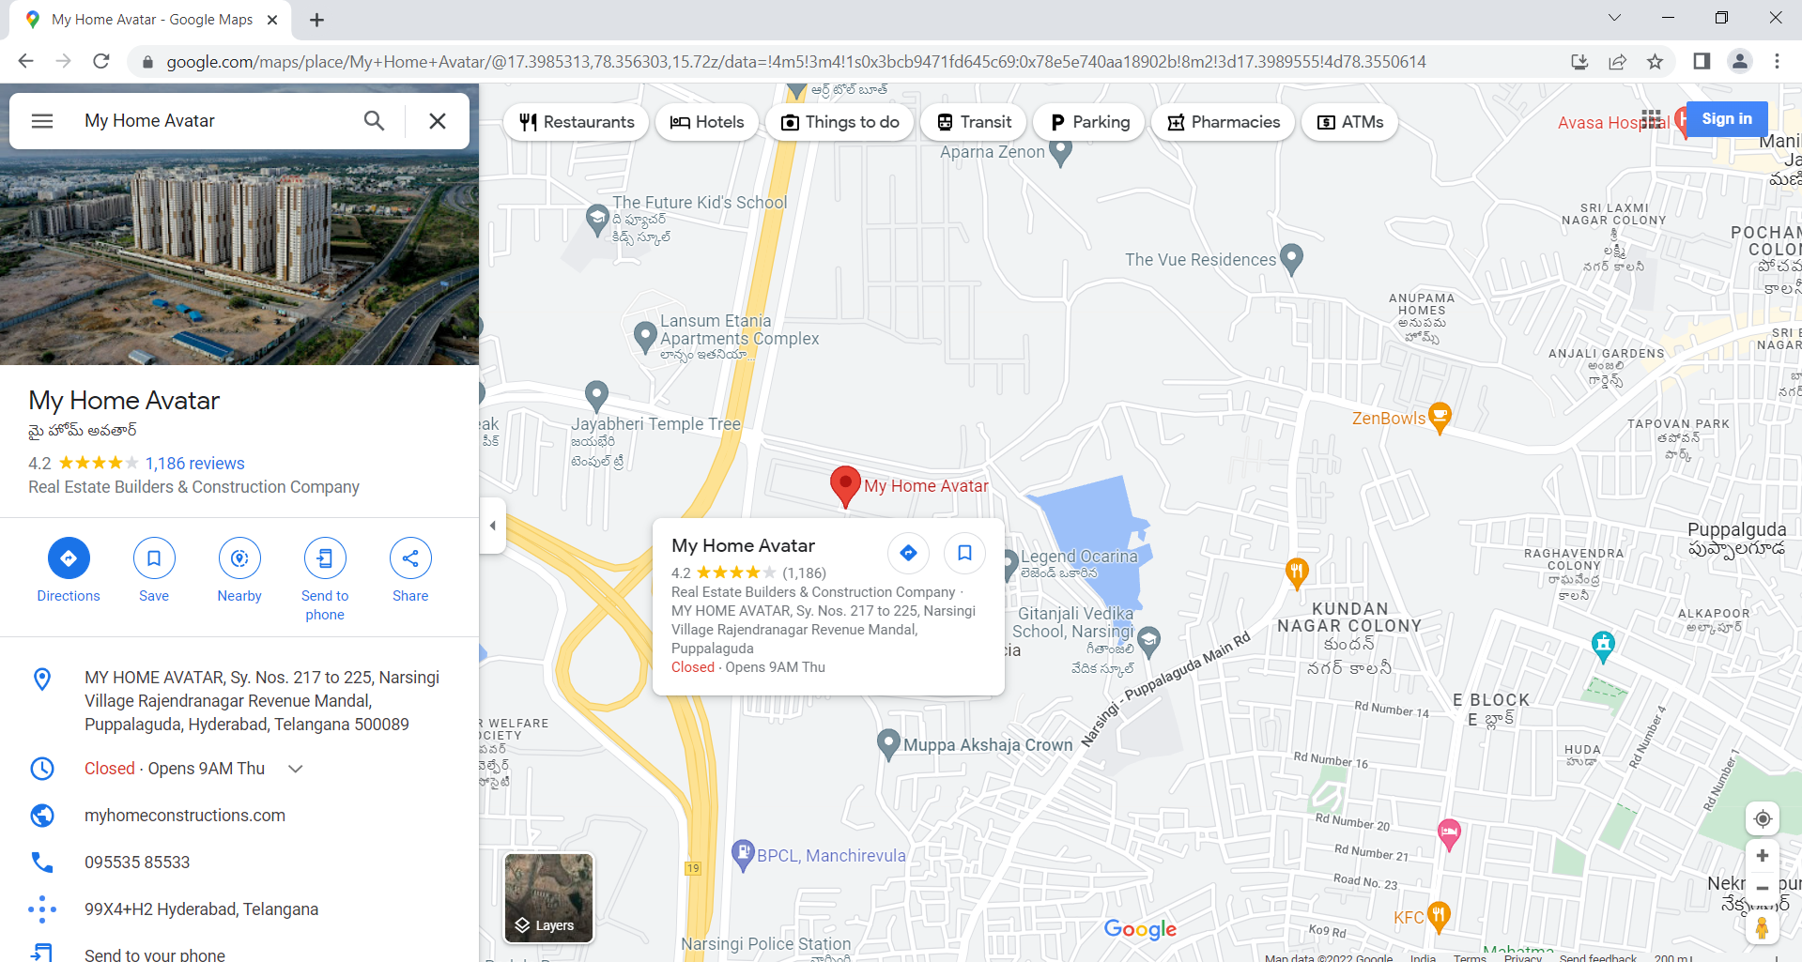
TEST CASES(cont..)
Case 3:
OUTPUT SCENARIO :-

Slide 17
REFERENCES
https://thesai.org/Downloads/Volume11No8/Paper_53-IoT_Based_Automatic_Damaged_Street_Light.pdf
https://nevonprojects.com/iot-streetlight-controller-system/
https://ijesc.org/upload/1eb3edd88907de6c42cde91d7245908f.Intelligent%20Street-Light%20System%20using%20Arduino%20UNO.pdf
https://www.researchgate.net/publication/348096383_Smart_Street_Lighting_System

